Slide 1
Project 4
CSE5345 – FUNDEMENTALS WIRELESS NETWORKS
Spring 2016
Karthikeyan Rajamani
Brijesh Dankhara
Bhat, Chinthan
Saroj Panda

Slide 2
Project Description
A grid of Sensortags is deployed on campus. Each of the tags is broadcasting an unique URL.
Created a customized Android Application, BeaconLogger(BL) that scans all the broadcasted URLs from its vicinity.
The application logs the URL with highest RSSI with Time stamp into the AWS RDS(MySql) Database in Cloud..
The app generates the user’s trajectory for a given time period relative to the Sensortags locations by processing the logged data.
The time spent on each location (User Interest) is indicated by area of the circle.

Slide 3
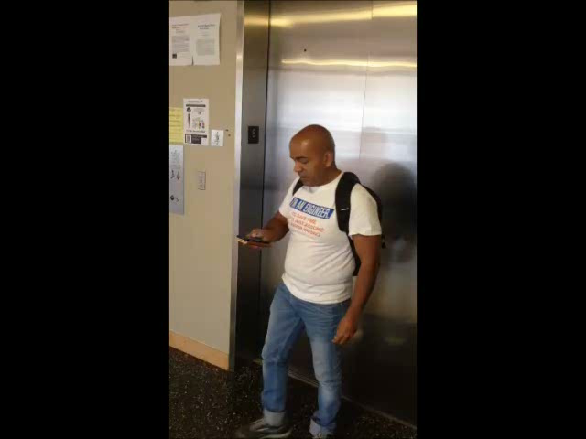
Project Demo Video

Slide 4
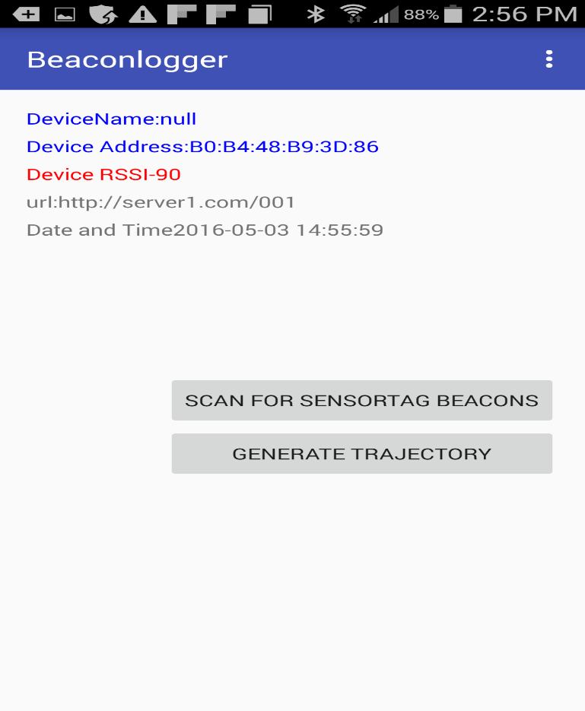
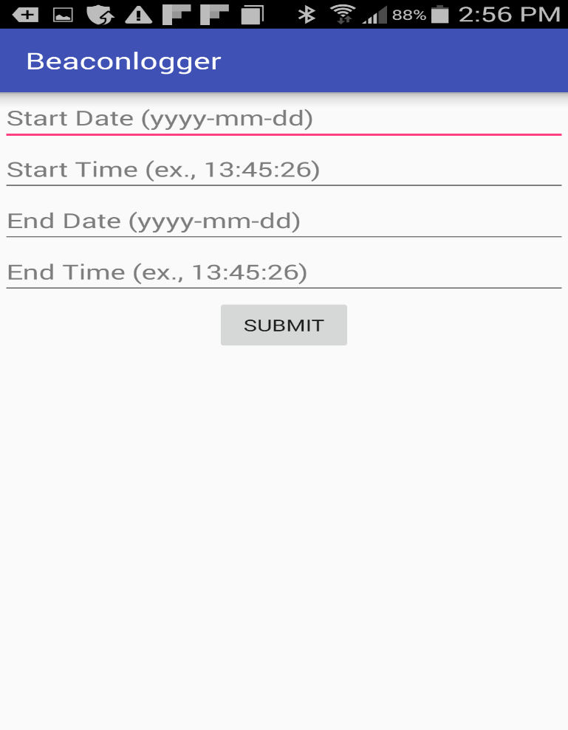
Application Screen Shots

Slide 5
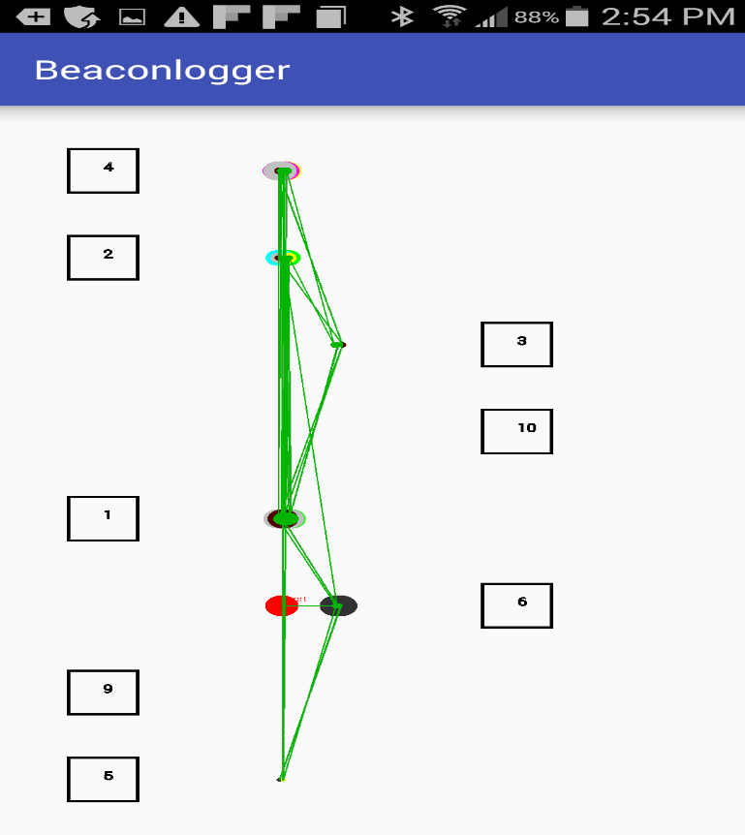
Application Screen Shots

Slide 6
IDE’s and devices used
SensorTag –CC2650STK from Texas Instruments
Samsung Galaxy S4(API-19)
Android Studio -1.5.1
AWS Cloud RDS(MySql)
PHP
MySQLWorkBench

Slide 7
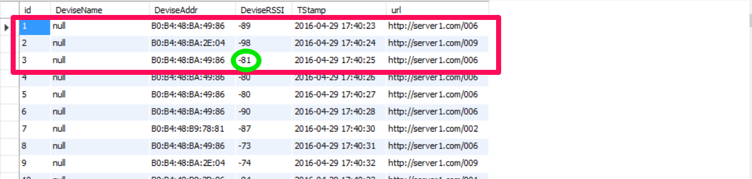
Problems And the Solutions
The BLE LEScan method returned the scan record(URL Data) in the raw byte format, that had to be parsed with PhysicalWeb app’s UriBeacon class parseFromBytes function to get the eddystone URL layout.
The Beacon RSSI values were fluctuating even for a stationary position because of Channel State and time difference between the broadcasts. This was solved by post processing the data, sampling 3 records at a time, and logging only the highest RSSI value record for report generation.

Slide 8
Problems And the Solutions
Initial Sequencial Plotting of the Trajectory was misleading and was fixed by redrawing the map based on actual Sensor Tag Locations.
The Trajectory was further refined by optimizing to the Phone screen and adding different colors.

Slide 9
Future Work
Dynamically Plotting Sensor Tag map for a large sensor tag network, based on the tags close to user vicinity.
Faster Response from Application using Memcache kind of techniques.
Add GPS functionality to the Application.

Slide 10
References
https://www.pubnub.com/blog/2015-04-15-build-android-beacon-ibeacon-detector/
http://developer.android.com/reference/android/bluetooth/le/BluetoothLeScanner.html#startScan%28java.util.List%3Candroid.bluetooth.le.ScanFilter%3E,%20android.bluetooth.le.ScanSettings,%20android.bluetooth.le.ScanCallback%29
https://aws.amazon.com/rds/
https://www.pubnub.com/blog/2015-04-14-building-android-beacon-android-ibeacon-tutorial-overview/
http://stackoverflow.com/questions/32836728/how-to-identify-eddystone-url-and-uid
http://processors.wiki.ti.com/index.php/SensorTag_User_Guide
https://newcircle.com/s/post/1553/bluetooth_smart_le_android_tutorial
https://www.000webhost.com/
http://stackoverflow.com/questions/30502132/how-to-pass-longitude-and-latitude-from-android-to-php-file-using-query-string
http://android-er.blogspot.com/2011/08/drawpath-on-canvas.html
https://google.github.io/physical-web/
https://www.youtube.com/watch?v=vqF127HL-r0

Slide 11
Thank you!

